Slide 1
What to check before you go
We will do our best to have all batteries charged. The night before, verify the batteries are fully charged. Please turn off the iPad, microphone and receiver. The black cable is to charge the microphone and receiver. The white cable is for the iPad. The white charging block can be used for all devices, one at a time.
When at the school
Avoid having the camera face an outdoor window
Power ON the iPad by pressing the power button for 5 seconds
Press the icon in the dock
Select your Supervisor Zoom link on the web page
Zoom will launch. If you are asked, to type in your first name.
Wait for the supervisor to admit you to the Zoom meeting
Test the audio & video with your supervisor. Ask for thumbs up to indicate that your voice is coming through clearly
- Disconnect receiver cable from the iPad to hear the supervisor speak to you (if needed)

Slide 2
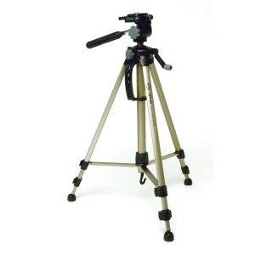
Tripod and iPad Mount
Extend 3 tripod legs to their maximum length, then spread the tripod legs.

Slide 3
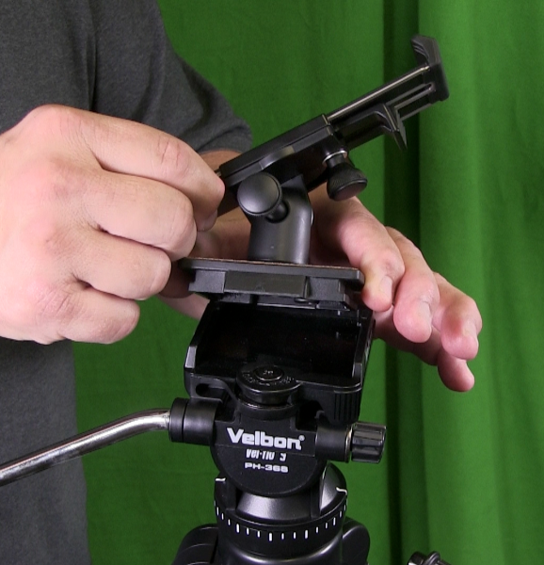
Tripod and iPad Mount
The iPad mount will be in the bag attached to the tripod shoe. Attach it to the tripod. Please verify that it is secure.

Slide 4
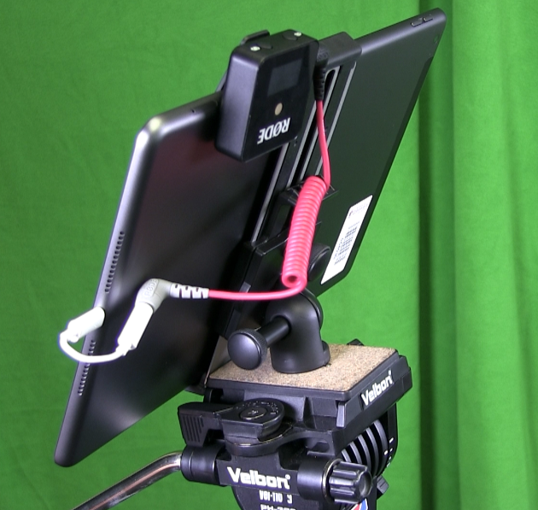
Tripod and iPad Mount
Insert the iPad into the mount.
Please watch the video on the next slide

Slide 5
Tripod and iPad Mount

Slide 6
Audio
Press and hold the power button for 3 seconds to turn the microphone ON.
Clip the microphone to outside of your clothing as close as possible to your mouth.

Slide 7
Audio
Press and hold the power button for 3 seconds to turn the receiver ON.
The units will already be paired and start transmitting audio.

Slide 8
Audio
Connect the black connector to the receiver.
Plug in the lightning adaptor into the iPad.

